Slide 1


Social Buzz

Slide 2


Today's agenda
Project recap
Problem
The Analytics team
Process
Insights
Summary

Slide 3

An audit of their big data practice.
Recommendations for a successful IPO.
An analysis of their content categories that
highlights the top 5 categories with the large st aggregate popularity.
Project Recap

Slide 4

Auditing of their Big data.
Identifying the 5 top categories
with the largest aggregate
Popularity.
Problem

Slide 5



Myself ( Data Analyst)
The Analytics team
Marcus Rompton (Senior Principle)
Andrew Fleming (Chief Technical Architect)

Slide 6
Process
1
Gathering of information about the data
Collect the data( downloaded the data)
Data cleaning
Data analysis
Discover insights
2
3
4
5

Slide 7
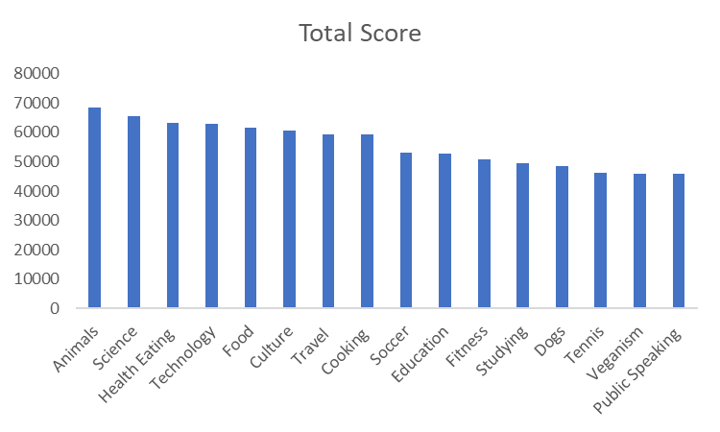

Insights

Slide 9
Number of unique Categories
16
Number of reactions to the most popular category
1738
Month with the most posts
MAY

Slide 10

From the chart titled “Total Score” the top 5 categories are ‘animals, science, health and eating, technology and food.
From this chart, you can see that people using Social Buzz are very interested Animals, healthy living, science and tech. This shows that the demographics of people using Social Buzz are mostly made up of the youths /young.
I would recommend increasing the number of post on the top 5 categories as the population Is a growing population which will increase the number of interactions and reactions to post on the website.
Summary

Slide 11
Thank you!
ANY QUESTIONS?

